Slide 1


EE307 Communication Systems
DEMONSTRATION OF
FREQUENCY
SHIFT KEYING
Presented by Group 8

Slide 2
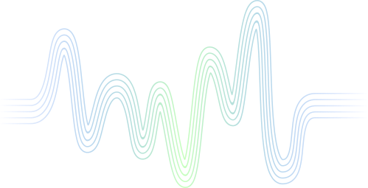


GENERAL
INTRODUCTION
Frequency Shift Keying (FSK) is a modulation technique used in digital communication systems to transmit digital data over a carrier wave. In FSK, the binary data (0s and 1s) is represented by shifting the frequency of the carrier signal between two distinct frequencies. The carrier signal is typically a sinusoidal wave, and the shift in frequency corresponds to the binary data being transmitted.

Slide 3

PROJECT OVERVIEW
Python Simulation:
Developed a robust Python program to simulate FSK modulation and demodulation.
Generated FSK signals by strategically shifting frequencies to represent binary data.
Implemented methods for demodulating received signals, establishing a fundamental software foundation for the project.
Simulink Analysis:
Constructed a comprehensive Simulink model to simulate an entire FSK communication system.
Integrated blocks for FSK signal generation, transmission through a simulated channel, and subsequent demodulation.
Facilitated in-depth analysis of FSK performance under controlled conditions, offering insights into its characteristics and behavior.
Multisim Circuit:
Translated theoretical concepts into practical application through a physical circuit in Multisim.
Engineered a circuit employing two transistors and various electronic components to achieve FSK modulation and demodulation.
Project Impact:
Executed a comprehensive exploration of FSK through a multi-faceted approach, combining software and hardware aspects.
Integrated Python, Simulink, and Multisim to provide a holistic understanding of FSK, bridging the gap between theoretical concepts and practical challenges.

Slide 4
PYTHON CODE
This code provides a comprehensive simulation of FSK modulation and demodulation, allowing for a clear understanding of the signal processing involved in digital communication systems.
Libraries such as NumPy is used for numerical calculations, array handling and Matplotlib for plotting graphs
The function, generate_fsk_signal,is used to generate a FSK modulated signal based on the provided parameters. NumPy is used to create time arrays (t), map binary message bits to corresponding frequencies, repeat the FSK signal to match the desired duration, and then modulate the signal using the sine function.
The demodulation function, fsk_demodulation it takes the modulated signal and extracts demodulated bits by analyzing the instantaneous phase and frequency of the signal. A threshold frequency determines whether a bit is '0' or '1'.
We have defined the parameters for the simulation, including the sampling frequency (fs), frequencies for '0' (f0) and '1' (f1), and the duration of the signal (duration).
A binary message is specified, and the FSK modulated signal is generated using the generate_fsk_signal function. The modulated signal is then demodulated using the fsk_demodulation function.
Four subplot figures shown in the next slide are created displaying the results for original message signal, FSK modulated signal, demodulated bits, and an overlay of the original and modulated signals.

Slide 5
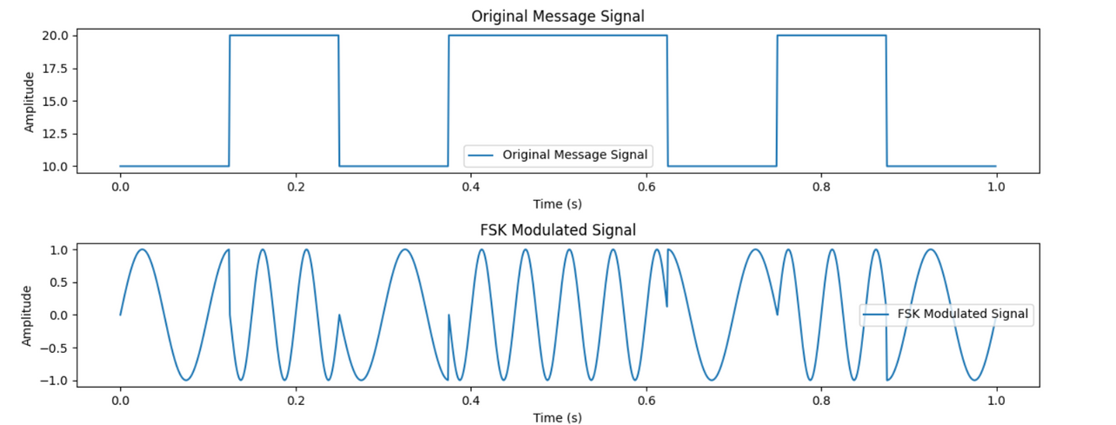
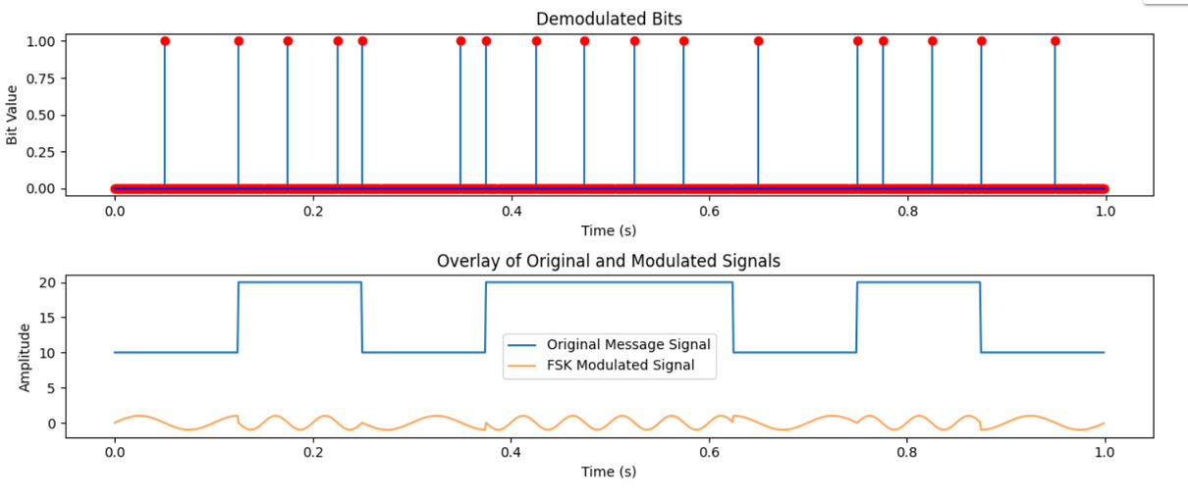
PYTHON CODE
FSK Modulation Plot
FSK Demodulation Plot

Slide 6
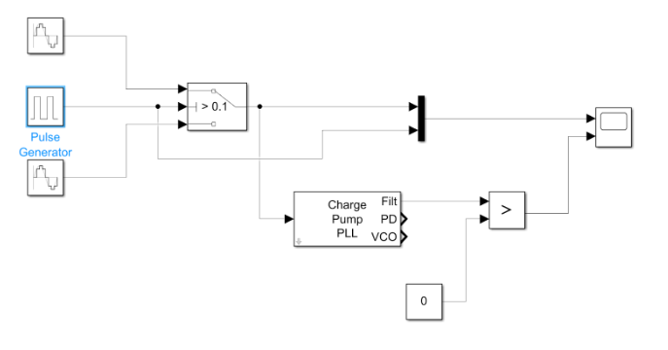
SIMULINK SIMULATION
FSK, a modulation method, alters a carrier signal's frequency to convey data. We conducted an experiment using Simulink to simulate FSK modulation and demodulation. Our aim was to grasp FSK's fundamentals and examine how modulation and demodulation impact signal transmission.

Slide 7
SIMULINK SIMULATION
(continued)
Modulation Circuit -
The modulation circuit is designed to implement Frequency Shift Keying (FSK) modulation. The Simulink schematic includes the following components:
Frequency input:
Generates a sine wave with a particular frequency. We used two of these with frequencies set to 12 Hz for high frequency input and 4 Hz for low frequency input.
Pulse wave generator:
Generates a rectangular pulse.
Ideal Switch:
An ideal switch that passes high frequency sine wave when pulse received from pulse wave generator is 1 and passes low frequency sine wave when pulse is 0.
Demodulation Circuit -
The demodulation circuit is designed to implement Frequency Shift Keying (FSK) demodulation. The Simulink schematic includes the following components:
Charge Pump PLL:
It automatically adjusts the phase of a locally generated signal to match the phase of an input signal. It acts as a Low Pass Filter.
Relation Operator:
Compares the output of the Charge Pump PLL to the constant value 0.

Slide 8
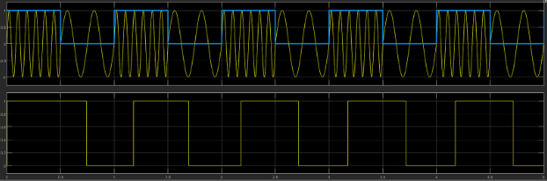
SIMULINK SIMULATION
(continued)
Observation -
We observed the following modulated and demodulated FSK waveforms. There is a phase shift induced in the demodulated waveform.

Slide 9
MULTISIM SIMULATION
The implementation of Frequency Shift Keying (FSK) modulation and demodulation using Multisim, unraveling the intricacies of signal transmission through the modulation and demodulation processes.
Major Circuit Components Needed:
Voltage Pulse Generator, Voltage controlled Oscillator, Xor gates for switching, Opamp Comparators, Rectifiers , Voltage Divider
Modulating Circuit
Starting with a comparator to get pulse for modulation. Further there’s ciruitry for including the signals to be modulated and amplified.
Demodulating Circuit
The output modulated wave is now fed to rectifiers further passed through peak detecting capacitive filters and then multiplied by the constant to have initial meassage wave.

Slide 10
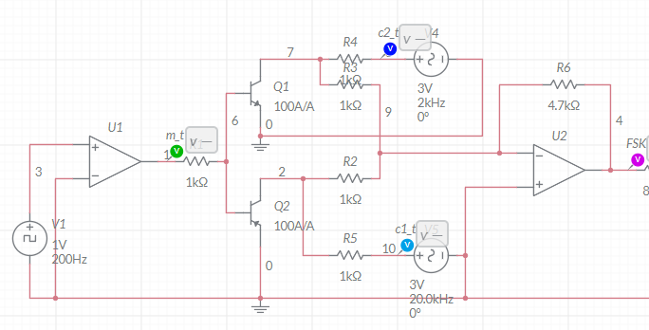
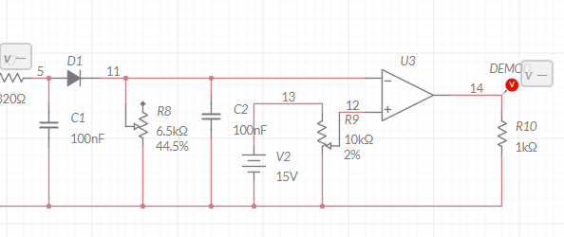
MULTISIM SIMULATION
(continued)
This is the circuit signifying modulating circuit implemented on Multisim
This is the circuit signifying demodulating circuit implemented on Multisim

Slide 11
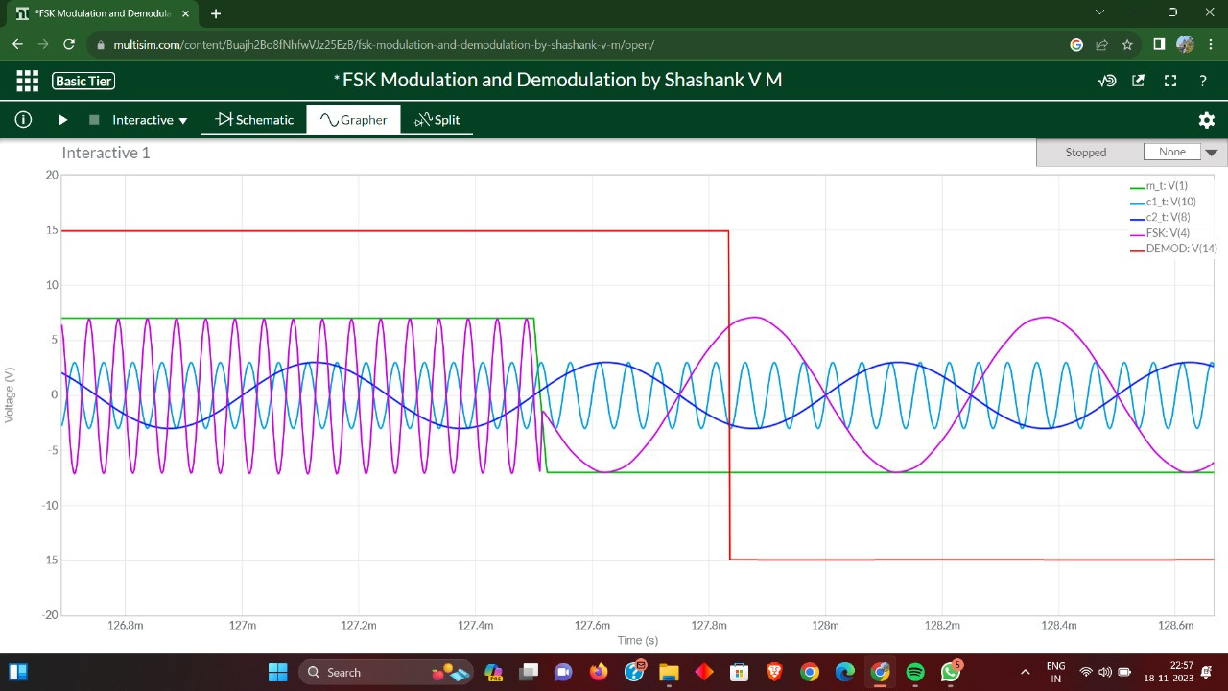
MULTISIM SIMULATION
(continued)
Results And WaveForm
Final Waveform of Modulated FSK, Demodulated FSK , initial square pulse waves.

Slide 12

ARDUINO IMPLEMENTATION
F high = 10Hz
F low = 2Hz
Modulated FSK Waveform

Slide 13
APPLICATIONS OF FSK
Telecommunications Usage:
Prevalent technology for voice and data transmission in telecommunications.
Efficient in scenarios like cordless telephones and walkie-talkies, enabling wireless human speech transmission.
Data Transmission in Various Industries:
Integral to data transmission, especially in RFID systems for object identification and tracking.
Leveraged in satellite communication systems for global communication and broadcasting.
Role in Data Transmission Systems:
Employed in computer networks for reliable transmission over telephone lines and in wireless technologies like Bluetooth and Wi-Fi for seamless connectivity.

Slide 14
APPLICATIONS OF FSK
(continued)
Digital Broadcasting and Entertainment:
FSK modulation enhances digital broadcasting systems (DTV and digital radio).
Ensures transmission of high-quality audio and video signals for an enhanced entertainment experience.
Industrial Automation and Control:
Utilized in industrial automation and control systems.
Enables transmission of control signals and sensor data, facilitating remote monitoring and control in manufacturing and energy sectors.

Slide 15
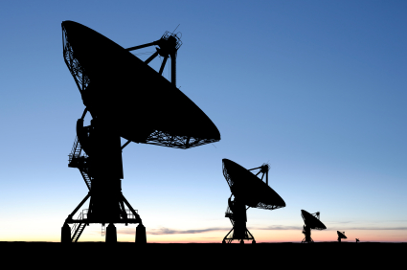
RELEVANCE IN PRESENT-DAY
Robustness: FSK is robust, especially in the presence of noise, but other techniques like QAM and OFDM can offer improved robustness.
Data Rate: Advanced techniques like QAM (Quadrature Amplitude Modulation) and OFDM (Orthogonal Frequency Division Multiplexing) generally support higher data rates compared to traditional FSK.
Bandwidth Efficiency: QPSK (Quadrature Phase Shift Keying), QAM and OFDM are more bandwidth-efficient than FSK, allowing for higher data transmission within the available spectrum.
In contrast to more advanced modulation schemes, FSK may not offer the same data rates or spectral efficiency. However, its relevance persists in specific use cases where its characteristics align with the communication requirements.

Slide 16
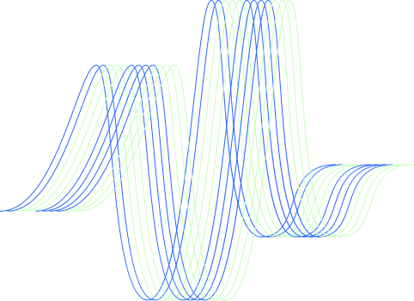
CONTRIBUTION DETAILS
Ranu Lal (210002061)
Multisim implementation
Report content on Multisim
Presentation content on Multisim
Rishabh Patil (210002062)
Multisim implementation
Report content on Multisim
Presentation content on Multisim
Ritika Dhaker (210002064)
Python code
Report and presentation content for Introduction, Applications and Relevance
Presentation template and design
Rupal Shah (210002065)
Python Code
Report content on Python
Report template and design using LaTeX
Saattvik Thourwal (210002066)
Simulink implementation
Report content on Simulink & Arduino
Arduino implementation
Sarthak Nandre (210002067)
Simulink implementation
Report content on Simulink
Presentation content on Simulink
Shaikh Baba (210002068)
Report content on Multisim
Presentation content on Multisim
Shashank Sharma (210002069)
Report content on Python
Presentation content on Python

Slide 17
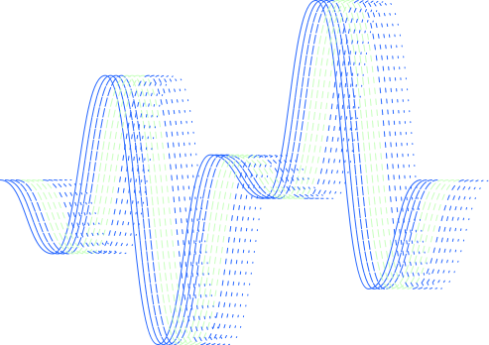
THANK YOU

